Slide 1
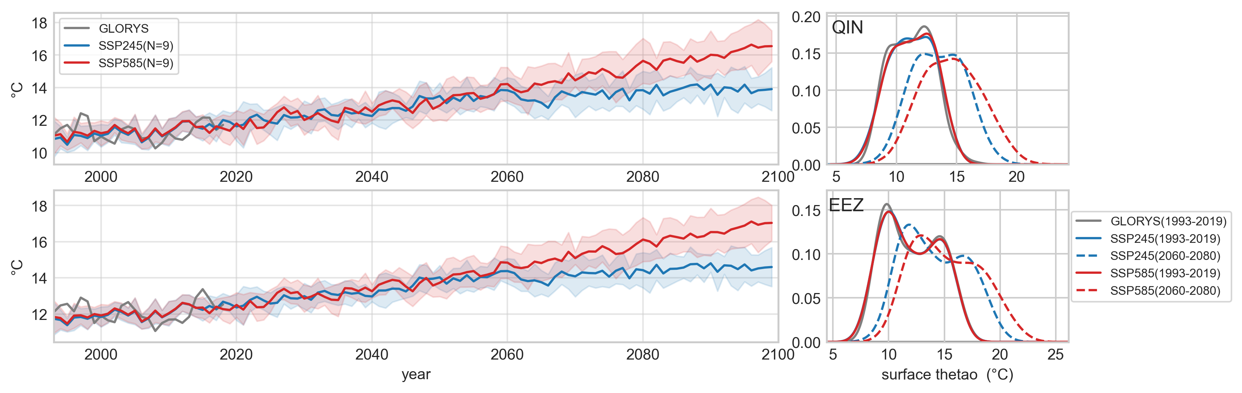
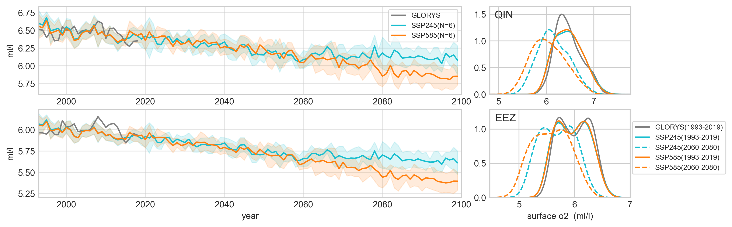
Surface trends, PDFs in 1993-2019 and 2060-2080 in two scenarios
Annual mean temperature
Annual mean dissolved O2

Slide 2
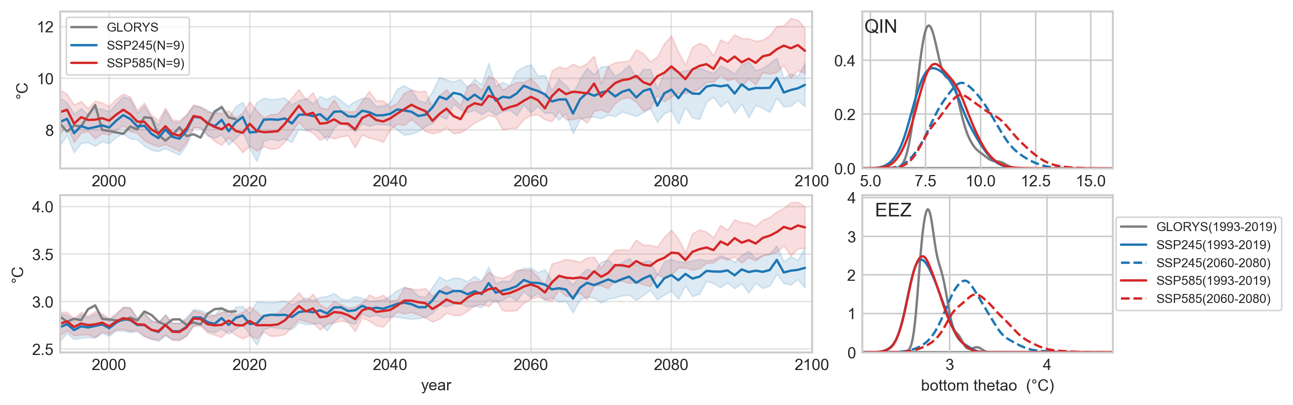
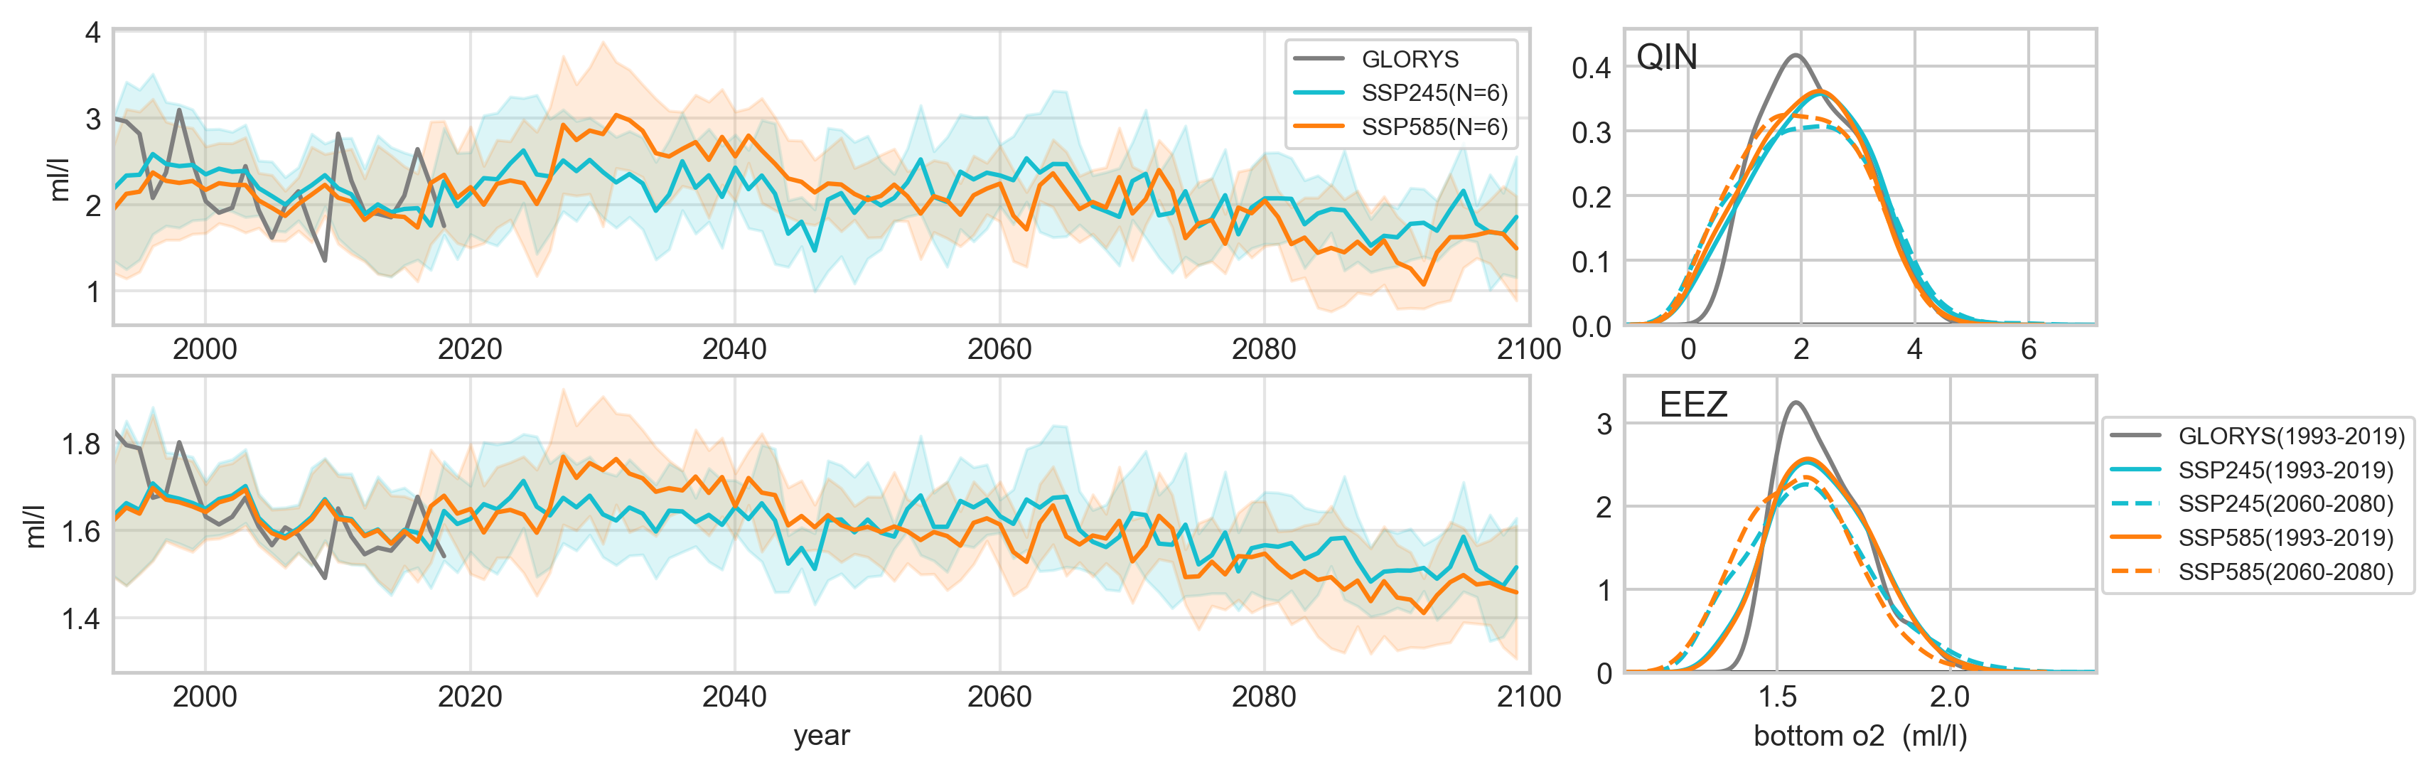
Bottom trends, PDFs in 1993-2019 and 2060-2080 in two scenarios
Annual mean temperature
Annual mean dissolved O2
Notes:
Large decadal-interdecadal variability in obs. and models due to internal variability and volcanic forcing (Fro ̈licher et al., 2009), Large in the ensemble? Downscaled?

Slide 3
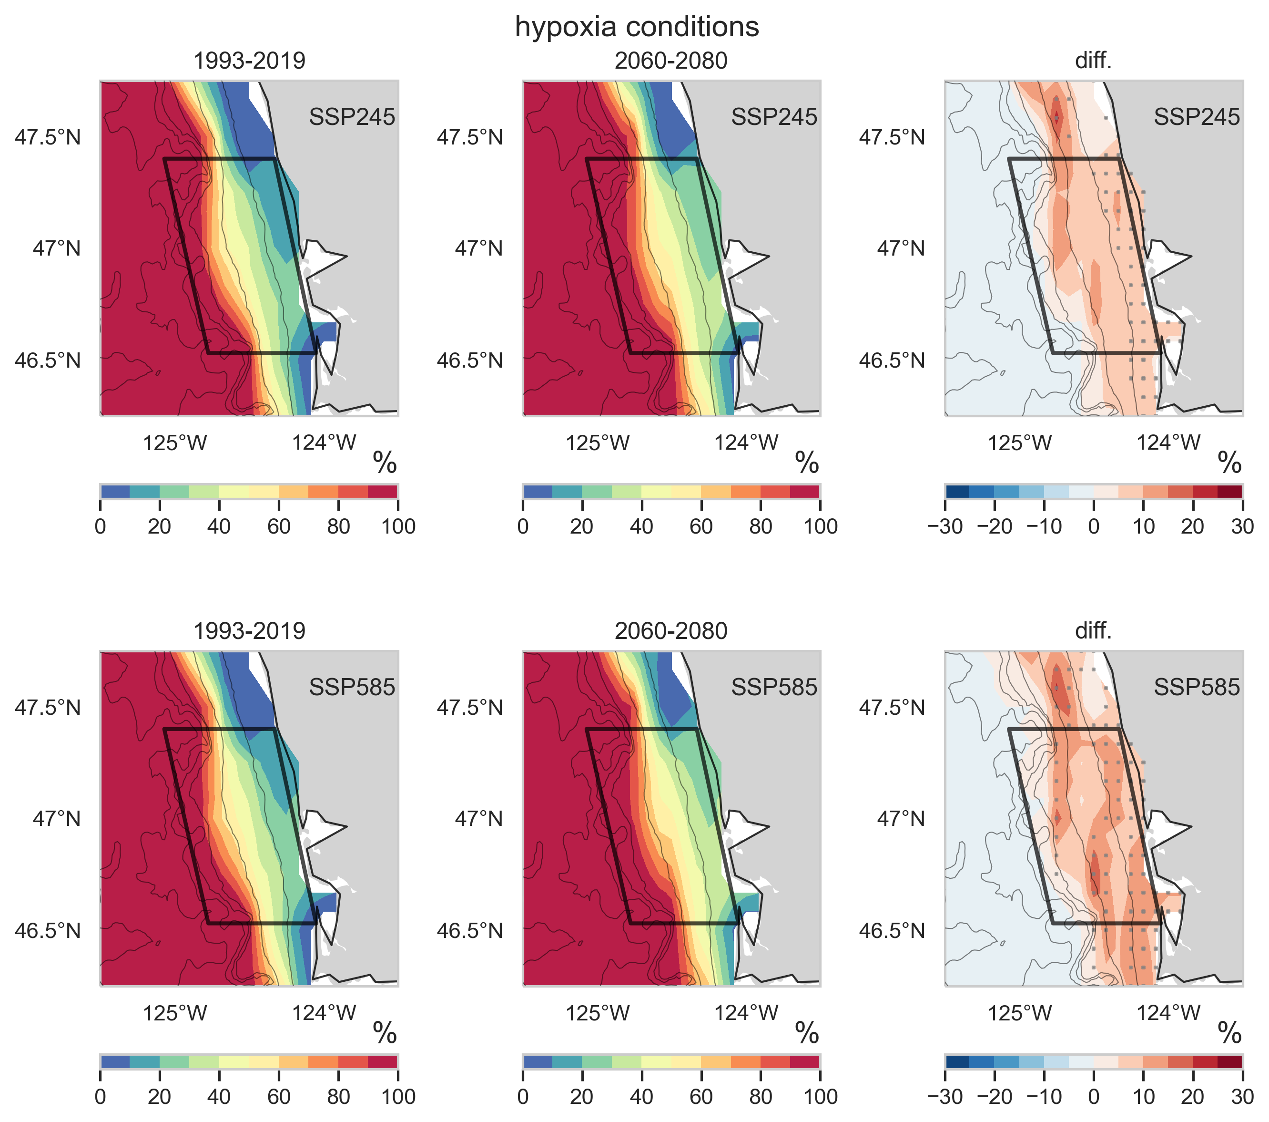
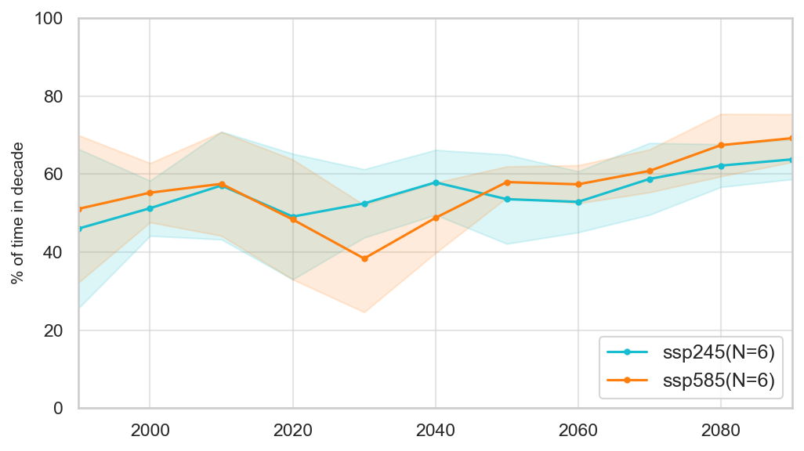
Hypoxia frequency, spatial patterns in 1993-2019 and 2060-2080 in two scenarios

Slide 4
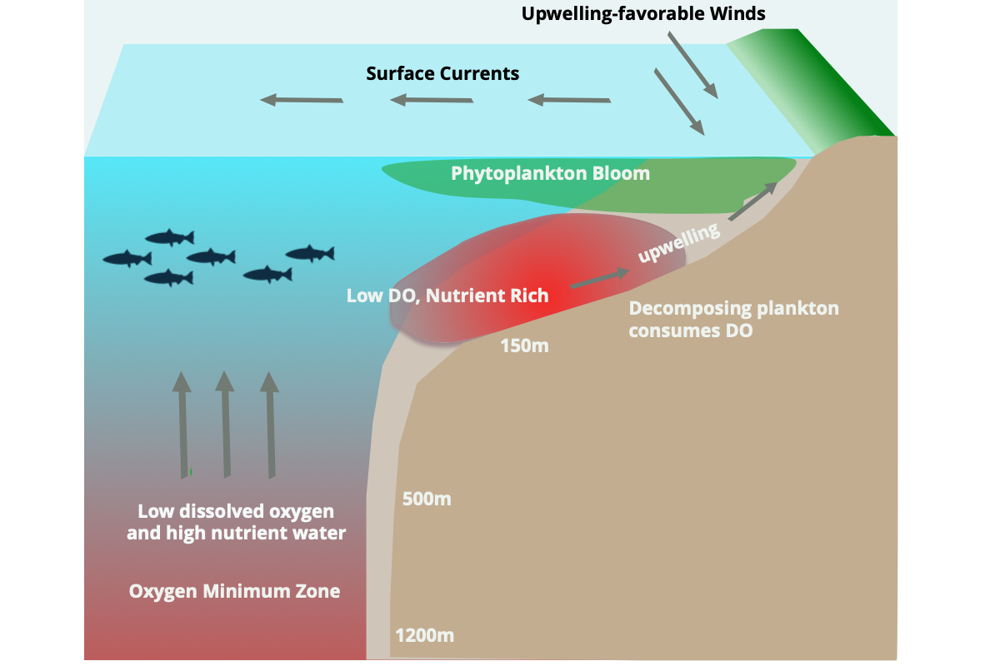
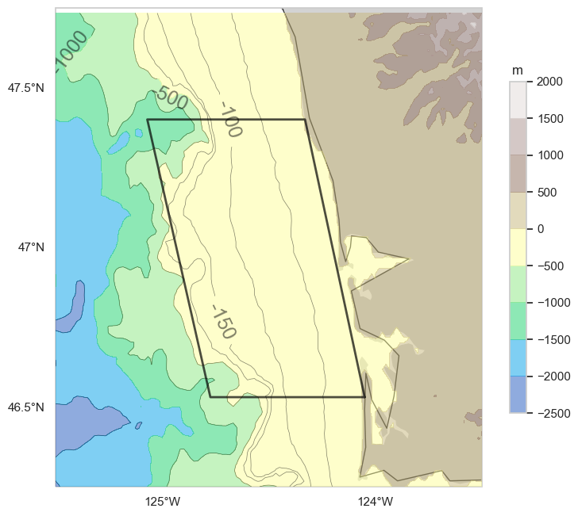
Oxygen Minimum Zone, Hypoxia and upwelling
Modified from Chan et al., 2019
this can be further modified adding biological processes if needed
Bathometry of QIN (m)
Notes:
https://vectr.com/

Slide 5
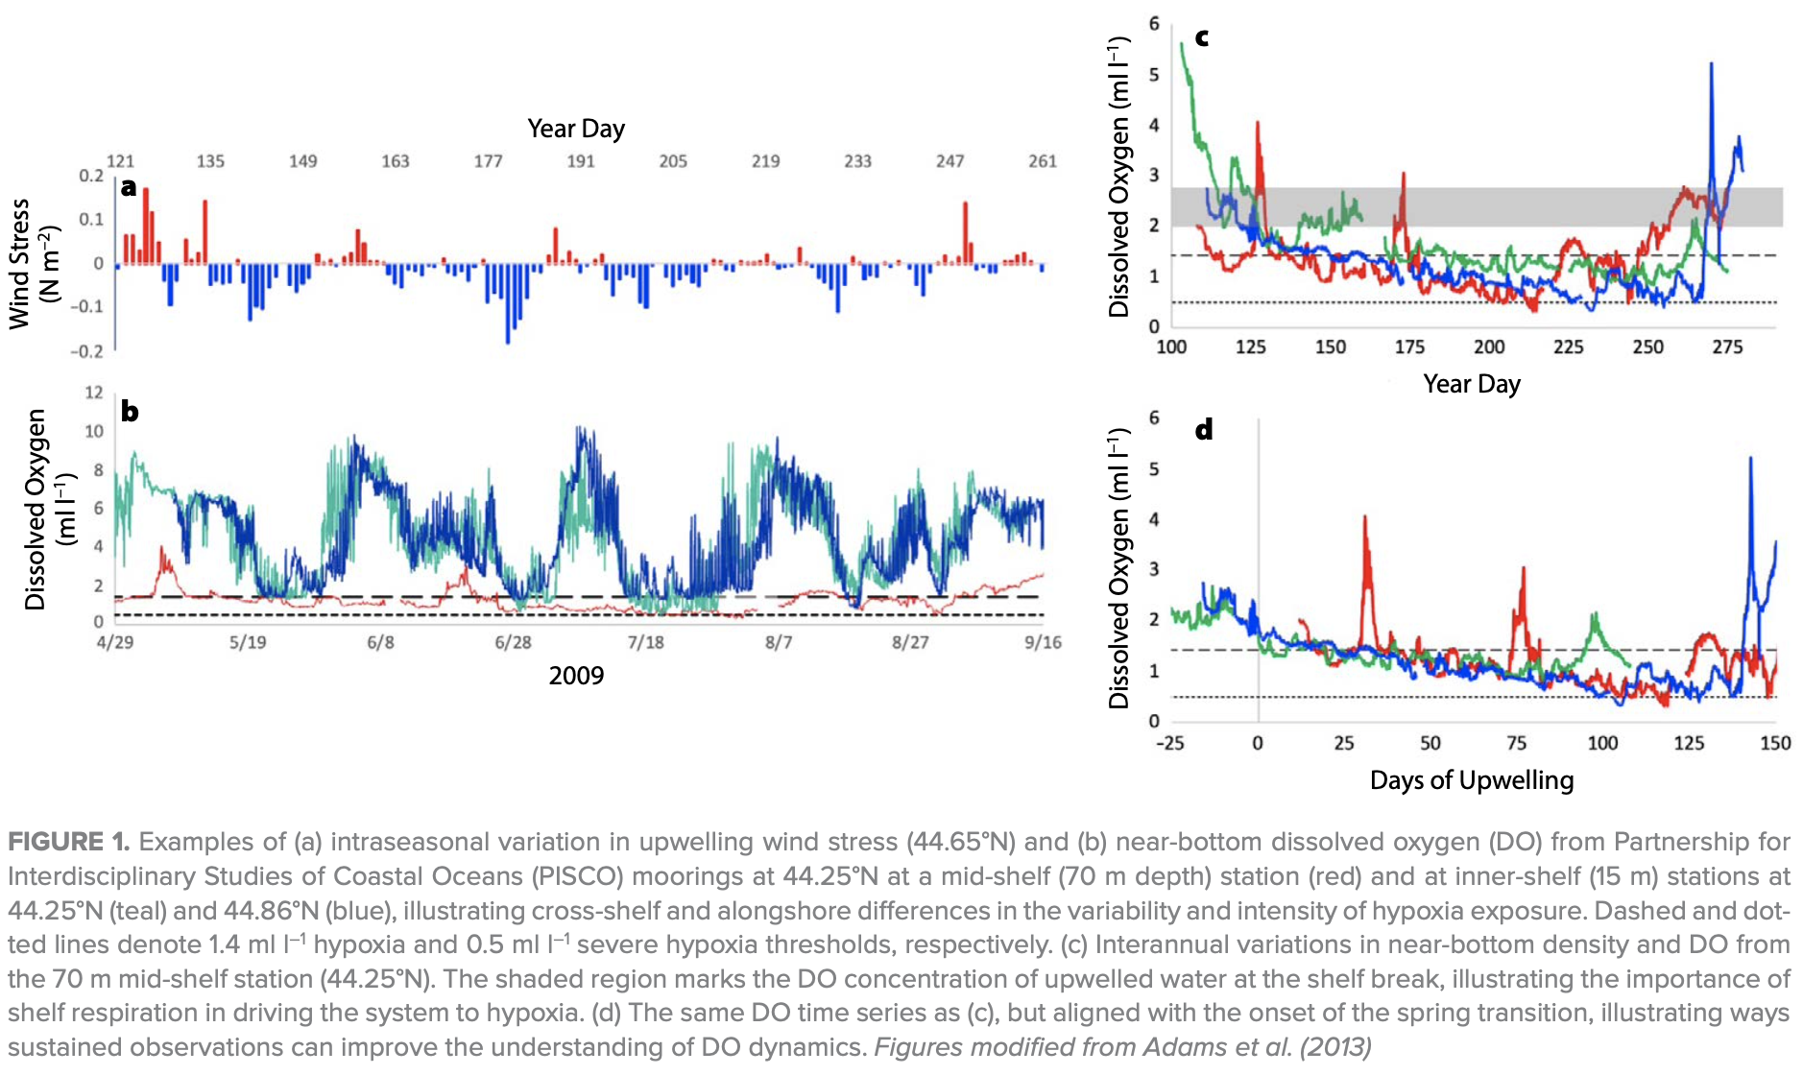
Timing of hypoxia and upwelling
Upwelling-favorable winds
Chan et al., 2019

Slide 6
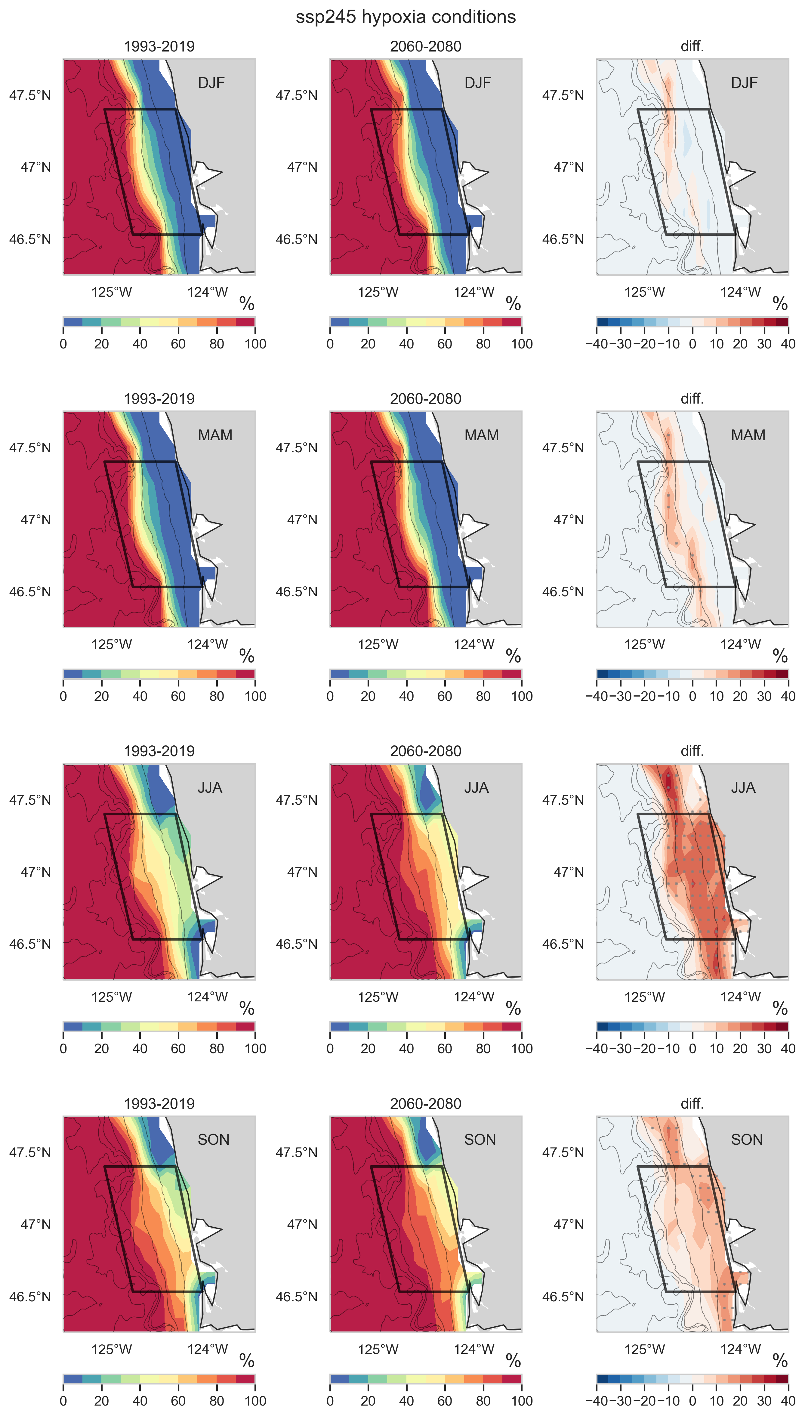
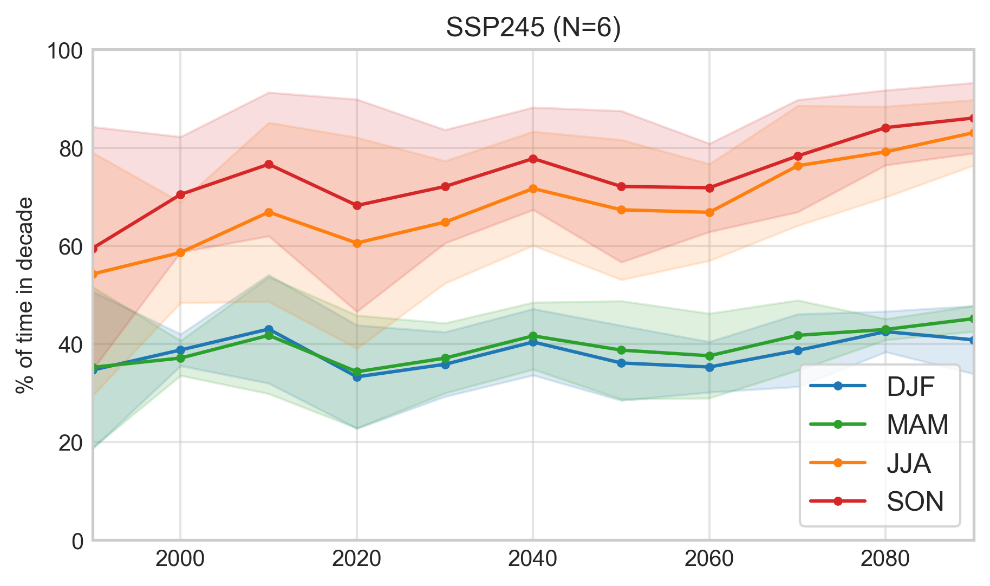
Seasonal hypoxia frequency and spatial patterns in 1993-2019 and 2060-2080 in SSP245
Notes:
Early onset, longer duration?

Slide 7
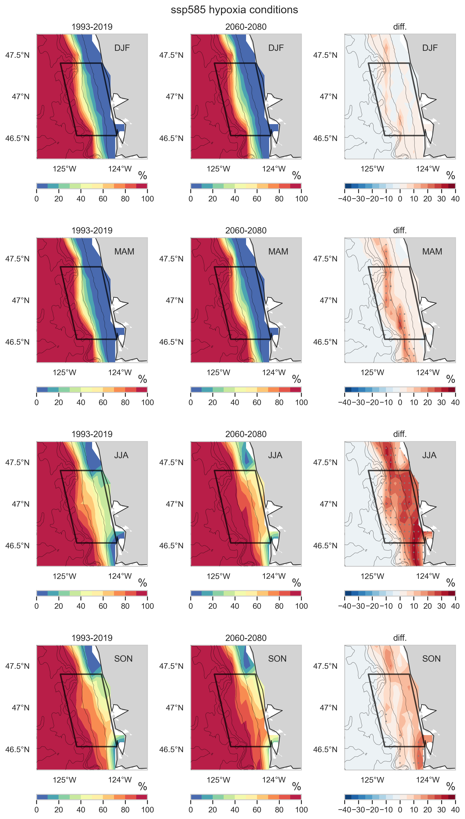
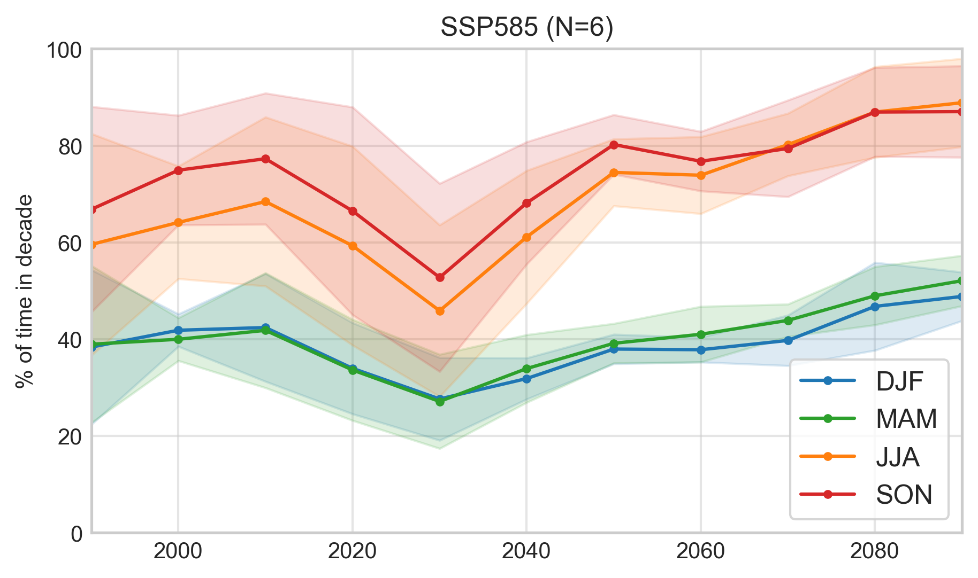
Seasonal hypoxia frequency and spatial patterns in 1993-2019 and 2060-2080 in SSP585
Notes:
Early onset, longer duration?

Slide 8
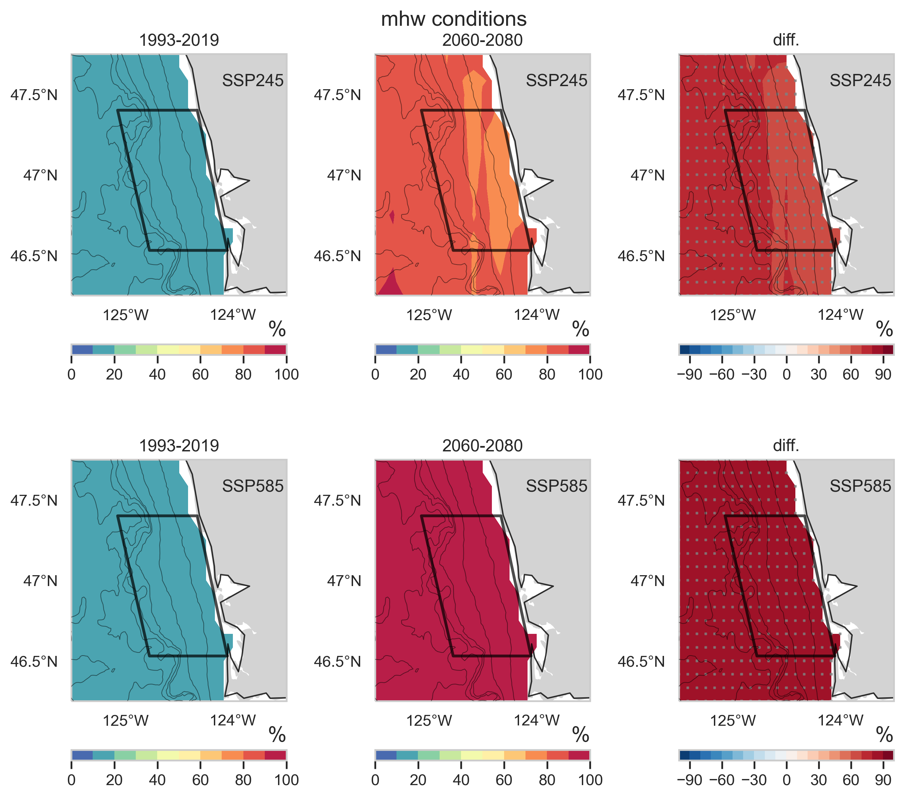
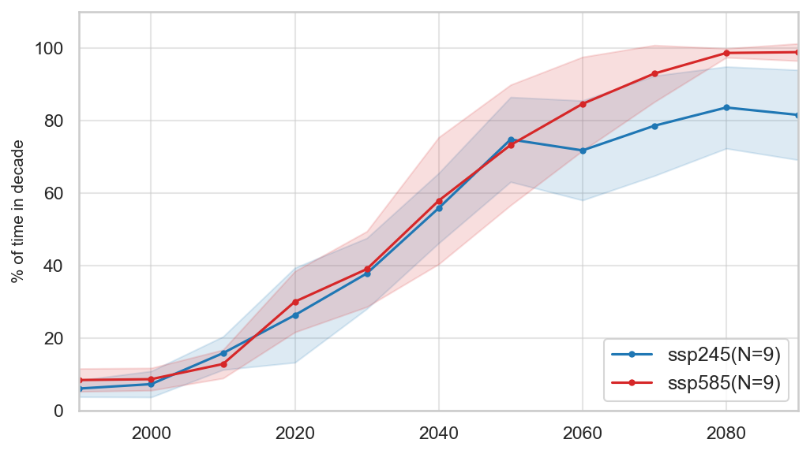
MHW frequency, spatial patterns in 1993-2019 and 2060-2080 in two scenarios

Slide 9
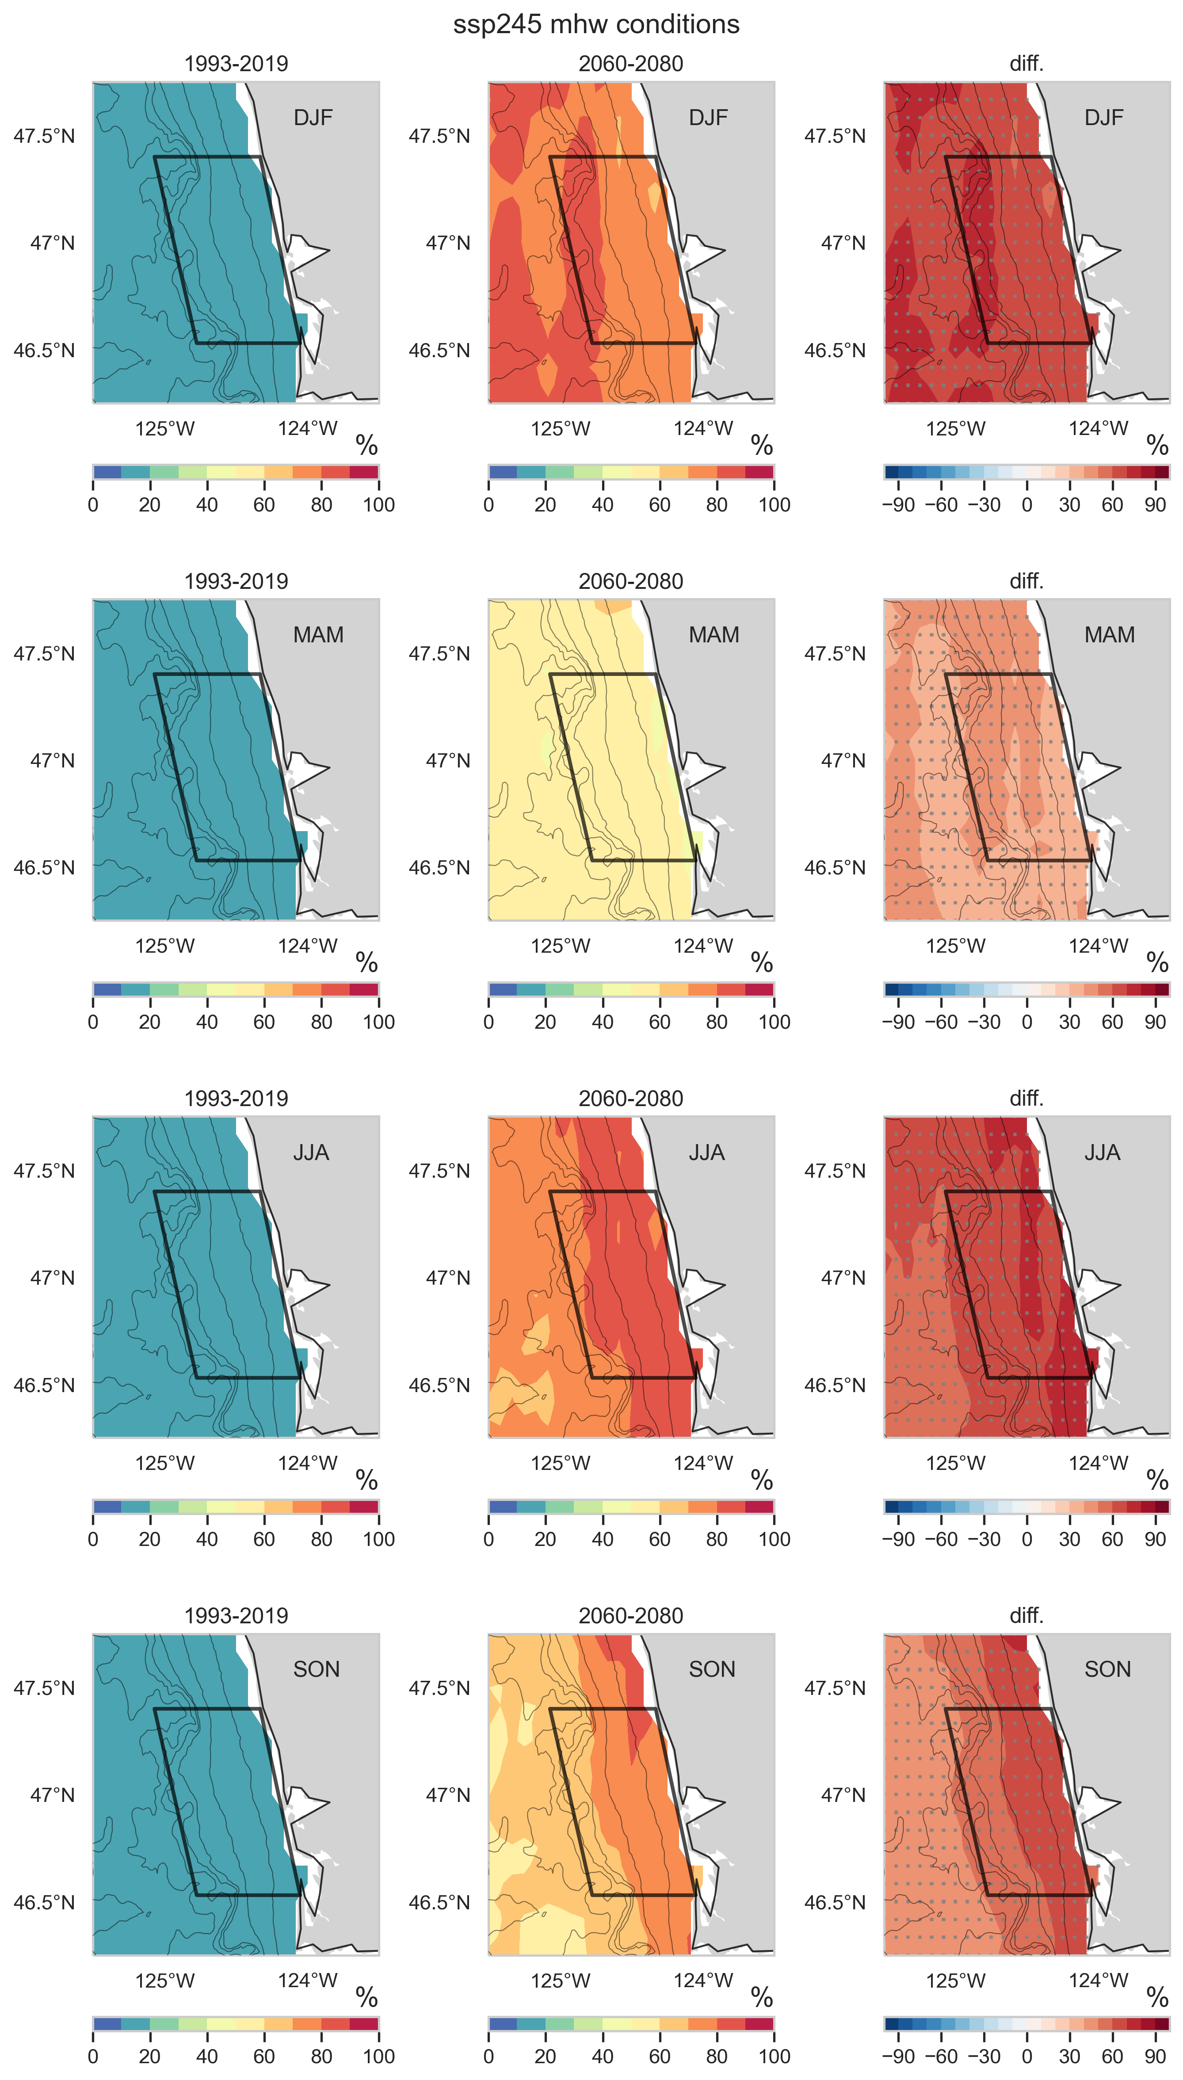
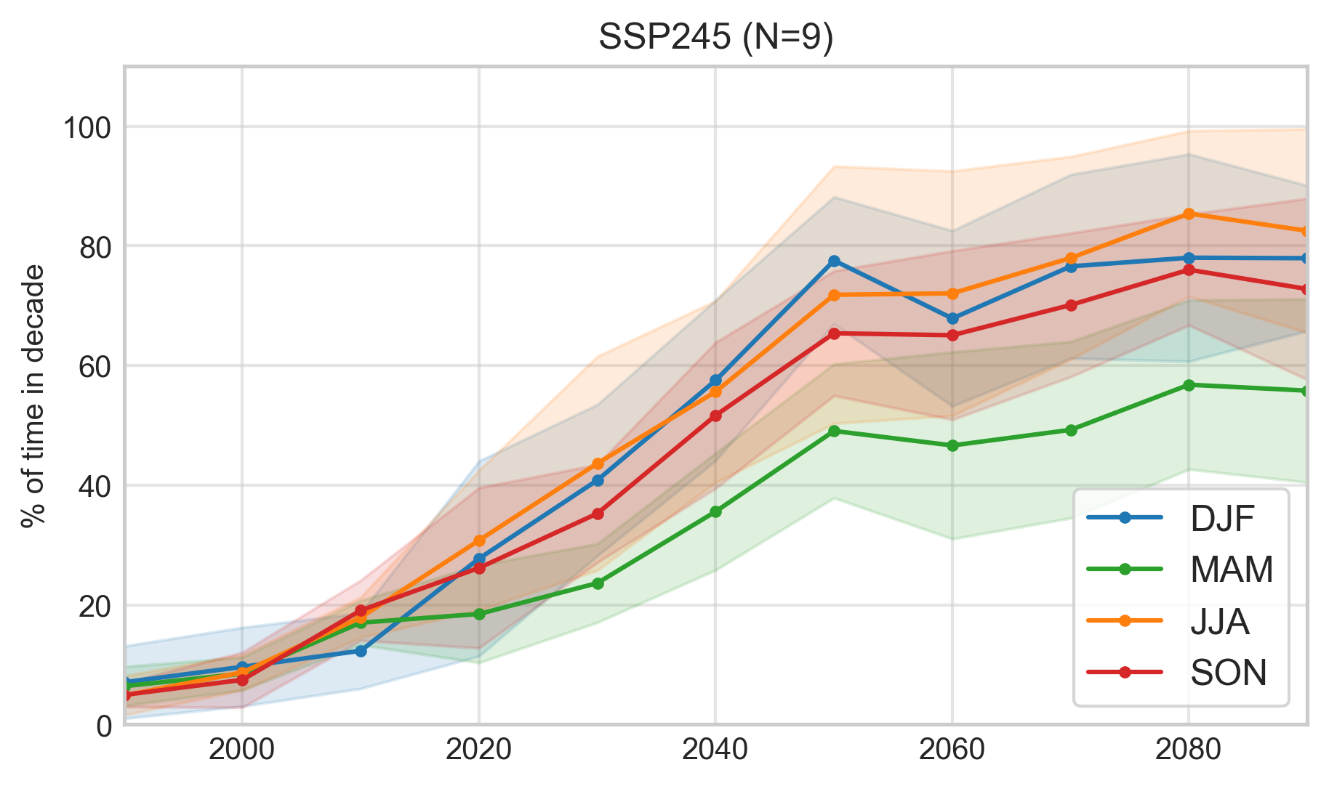
Seasonal MHW frequency and spatial patterns in 1993-2019 and 2060-2080 in SSP245

Slide 10
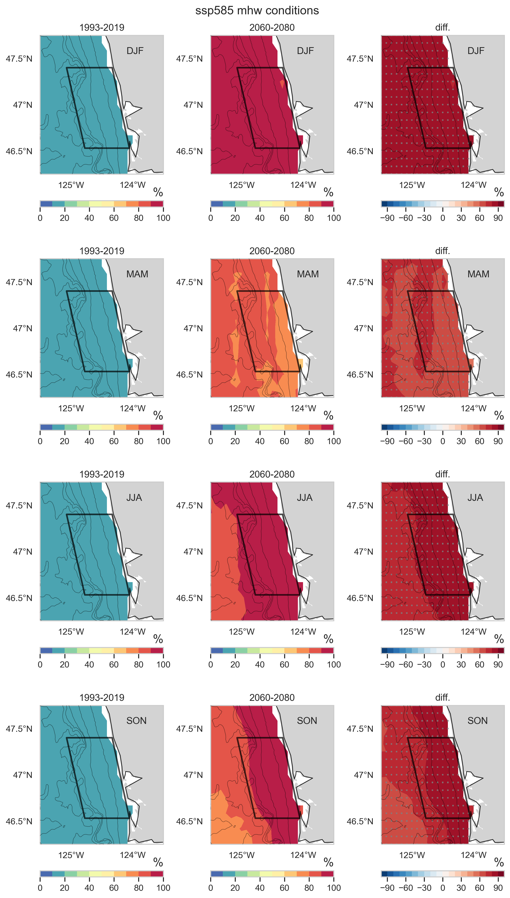
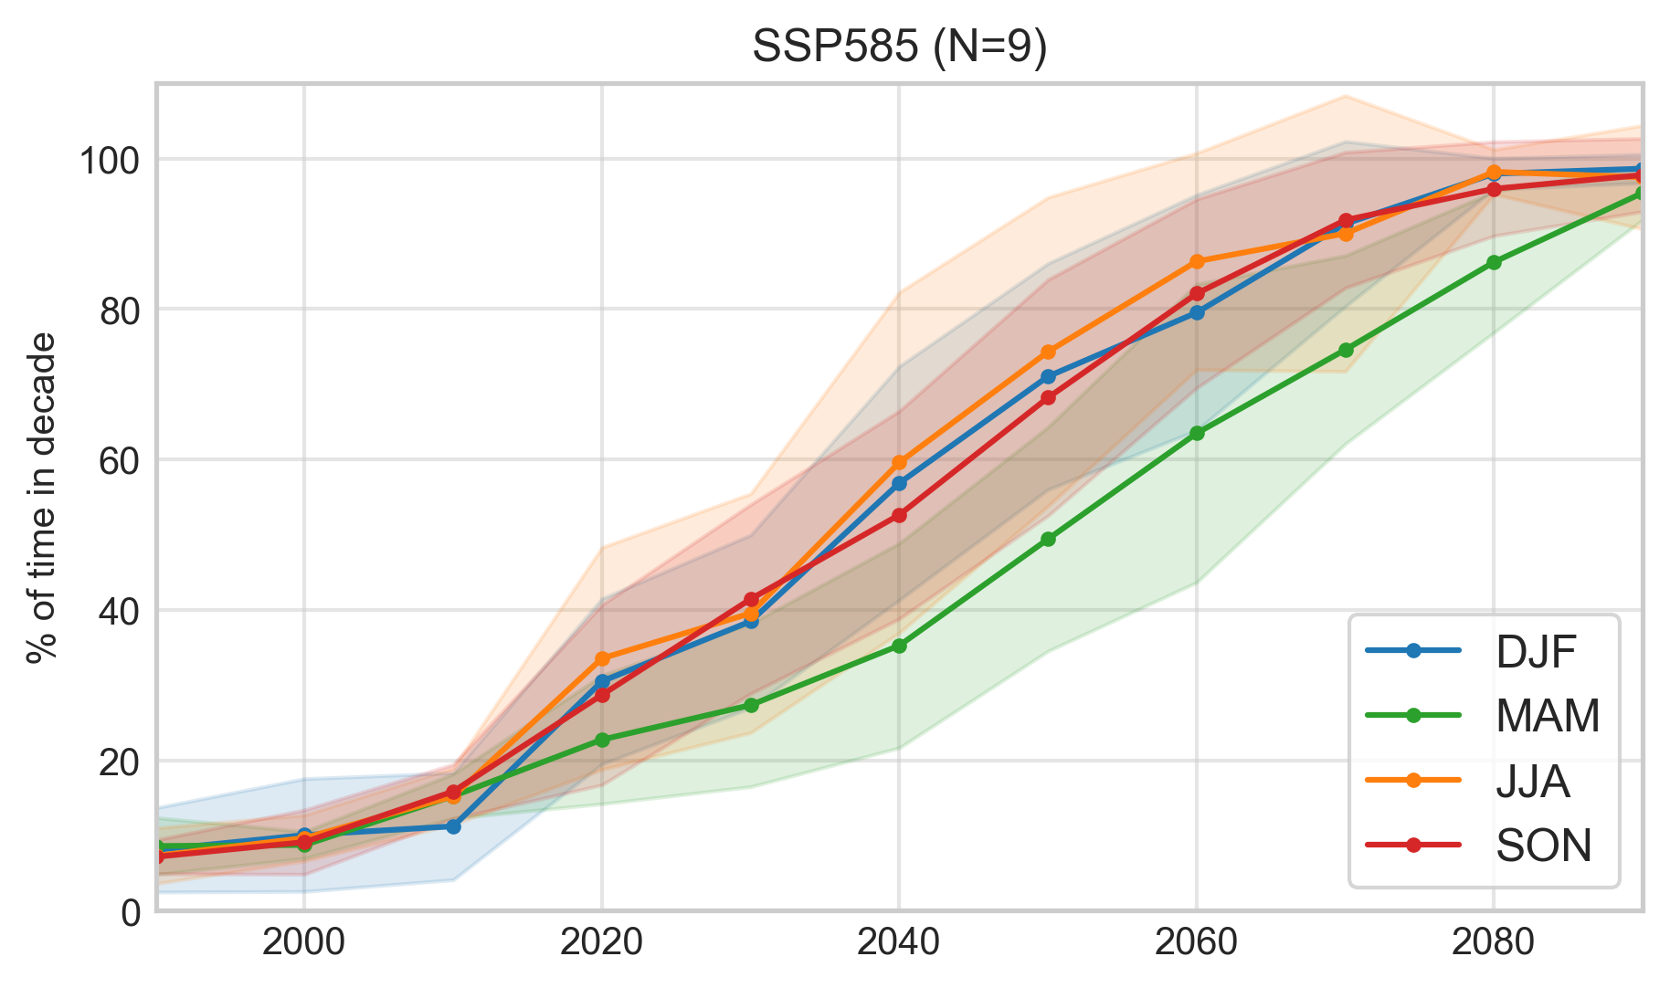
Seasonal MHW frequency and spatial patterns in 1993-2019 and 2060-2080 in SSP585

